Slide 1
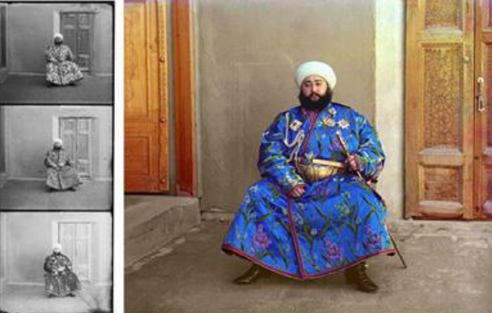
MINI PROJECT 1: COLORIZING PROKUDINGORSKII IMAGES OF THE RUSSIAN EMPIR

Slide 2
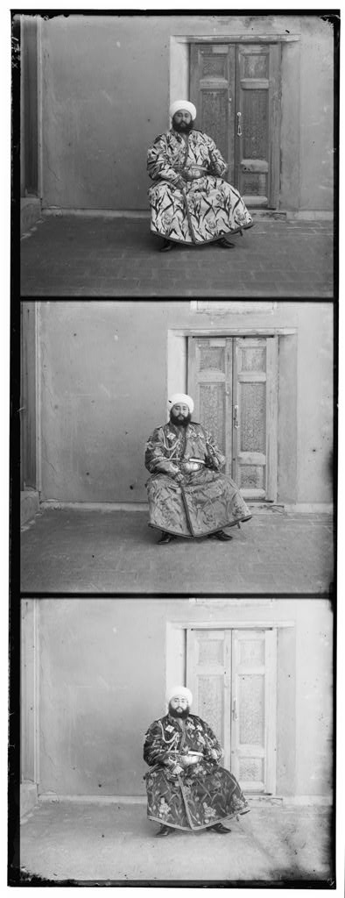
Abstract:
The goal of this assignment is to take RGB individual images and with some image processing techniques, to automatically produce a color image. In order to do this, we will need to extract the three-color channel images, place them on top of each other, and align them so that they form a single RGB color image.

Slide 3
Steps through implementation :
Extract R, G and B channels.
Mutual alignment between channels.
The sum of squared differences (SSD) .
the normalized cross-correlation (NCC) .
[BONUS POINT] pyramid approach.

Slide 4
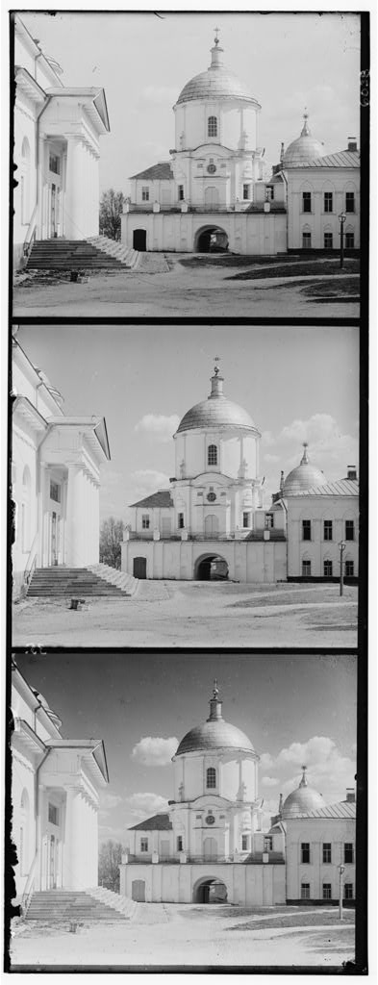
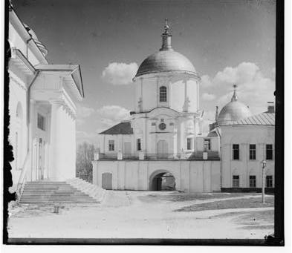
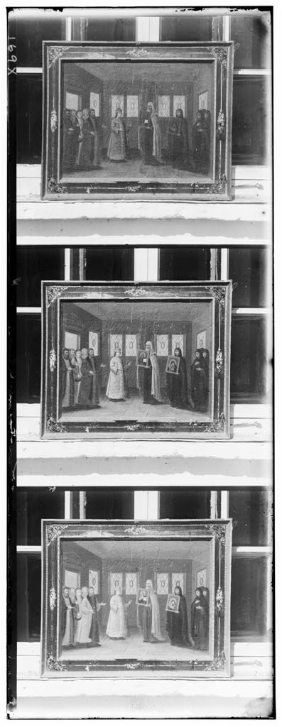
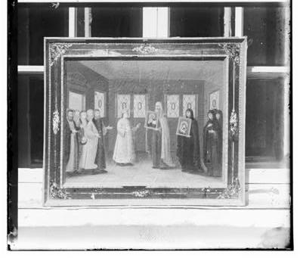
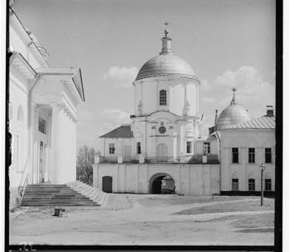
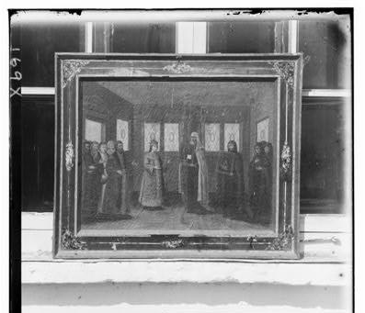
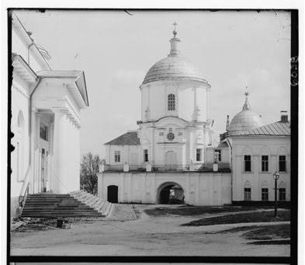
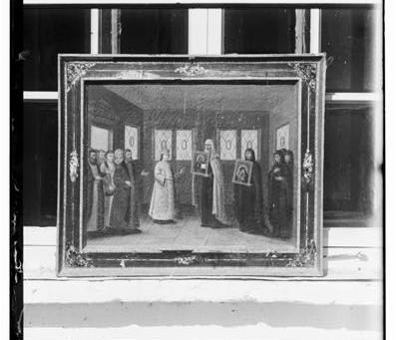
Extract R, G and B channels.

Slide 5
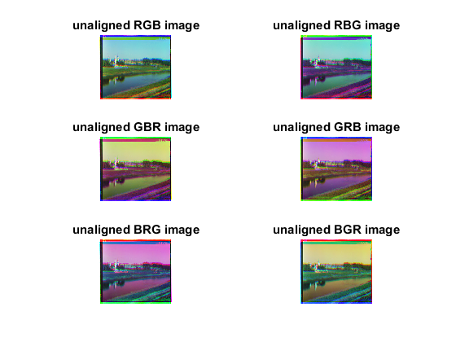
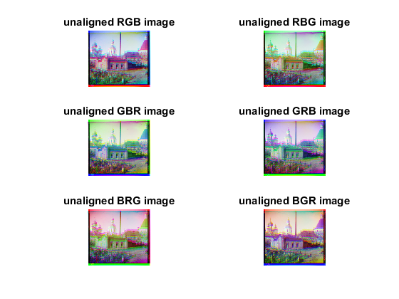
2. Mutual alignment between channels.
Aligning two of the channels to the third channel which will be the reference. And produce the following combinations:

Slide 6
3. The sum of squared differences (SSD)
Algorithm steps:
crop background image.
For loop
Move foreground Image inside the for loop i,j
Use circshift to shift the elements of matrix by i,j position.
cropping the shifted foreground image.
Apply SSD.
comparison to find best fitted foreground.
End
Output the aligned image.

Slide 7
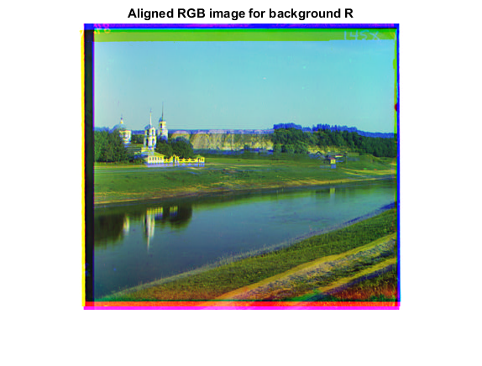
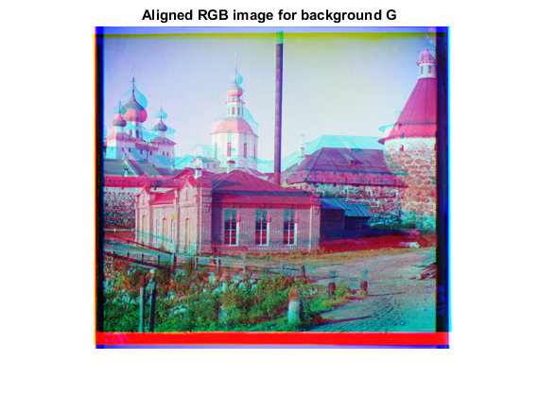
Results for the best aligned image of SSD:

Slide 8
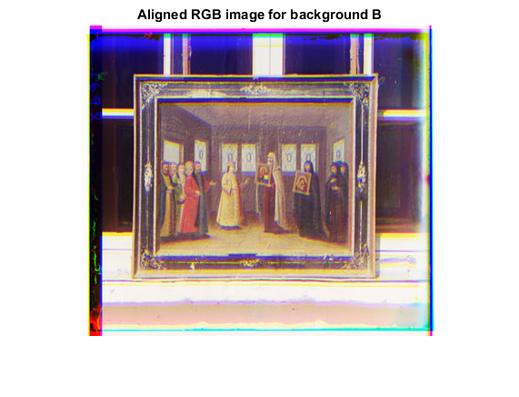
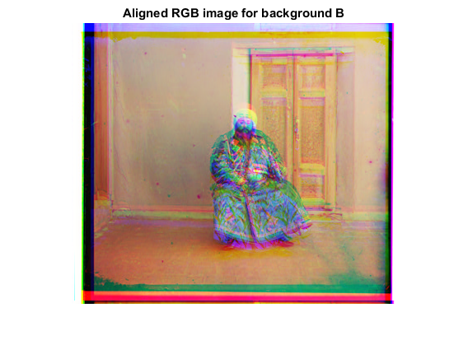

Slide 9
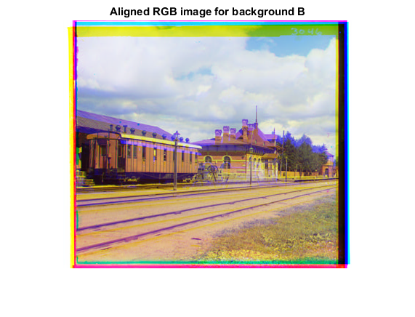
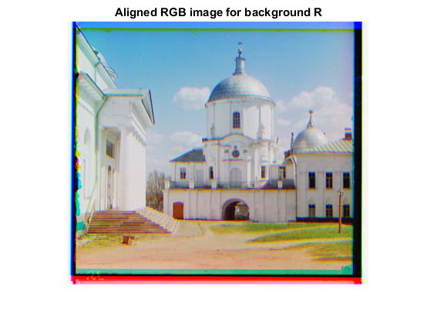

Slide 10
3. Improved SSD method:
when we see the previous results of the SSD method we find that:
there is unneeded border which effect on our results
so we should crop this channel with some ratio and redo the SSD method on the new channels.
(New cropping ratio: p=0.15)

Slide 11
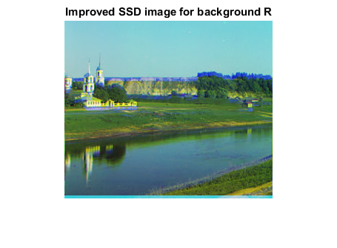
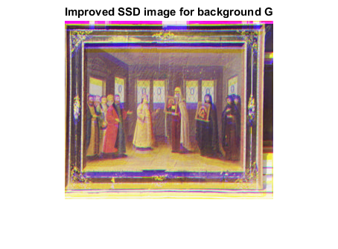
Results for the best aligned image of improved SSD:

Slide 12
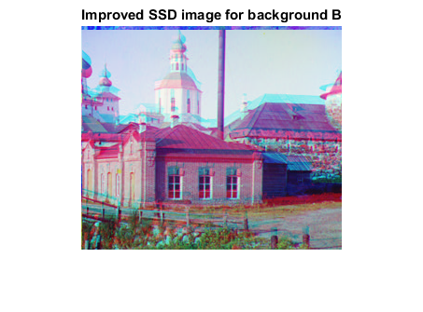
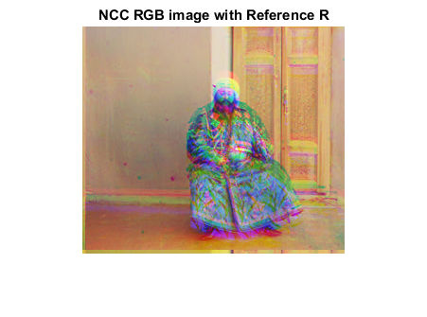

Slide 13
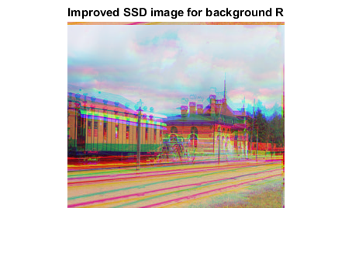
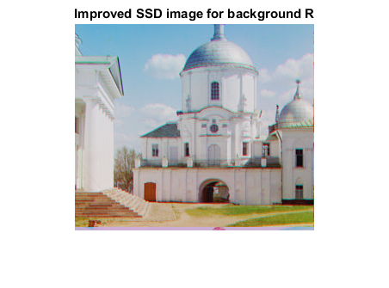

Slide 14
4. The normalized cross-correlation (NCC)
Algorithm steps:
normalize the reference image.
For loop
Move foreground Image inside the for loop i,j
Use circshift to shift the elements of matrix by i,j position.
normalize the aligned image.
Apply NCC.
find the maximum correlation.
End
Output the aligned image.

Slide 15
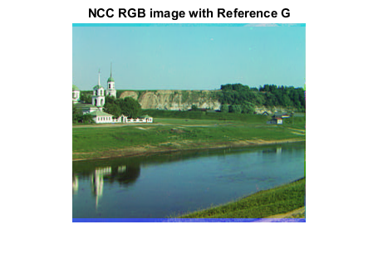
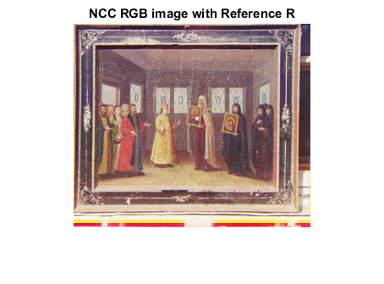
Results for the best aligned image of NCC:

Slide 16
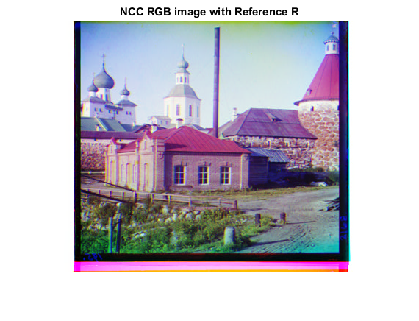
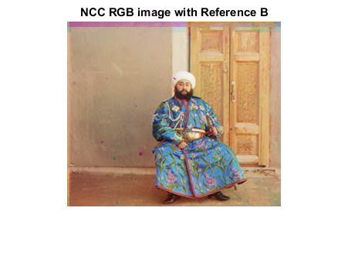

Slide 17
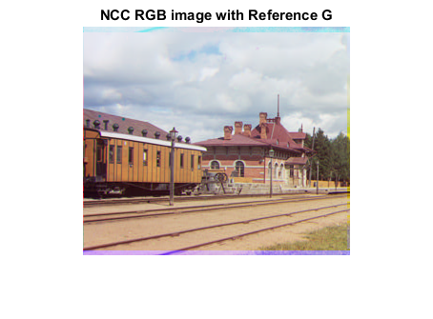
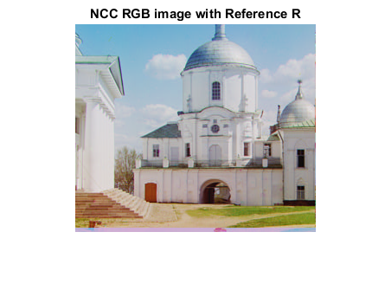

Slide 18
5. [BONUS POINT] pyramid approach
Algorithm steps:
Check if it is top of the pyramid image.
For loop
impyramid for aligned image ‘computes a Gaussian pyramid reduction’
impyramid for reference image.
shift back.
Use circshift to shift the aligned image by the previous shift .
End
Output the aligned image.

Slide 19
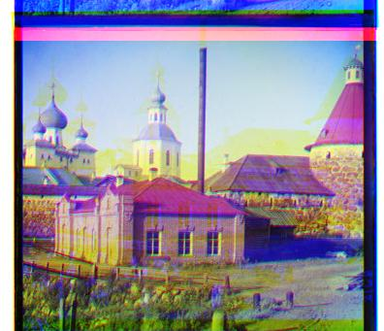
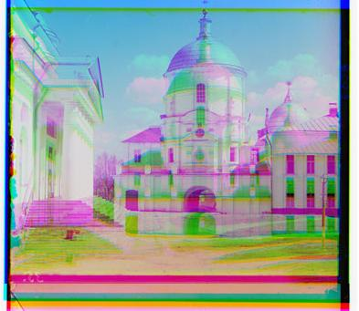
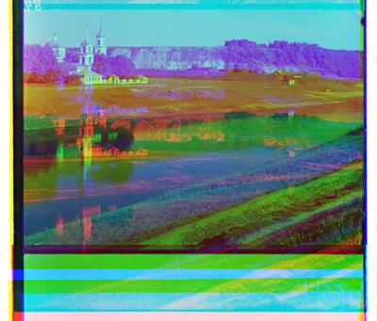
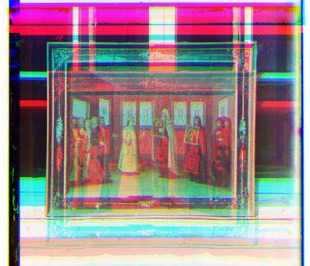
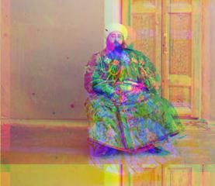
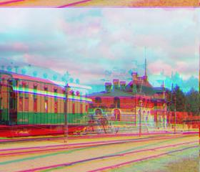
Results for the best aligned image of pyramid approach:

Slide 20
Conculation :
From the previous results which we obtained it from make a combination of the three channels, using the alignment through using the sum of squared differences (SSD) the normalized cross-correlation (NCC) or using the pyramid approach
we find that no certain method give us best quality for all the Prokudin-Gorskii glass plate images but every method have its cons and pros in certain area
such as using the sum of squared differences (SSD) on the image( 00125v.gif) it gives results close to the results which obtained from the normalized cross-correlation (NCC) but in the pyramid the results have less quality then the two methods.
So, it is up to you to choose whose is the best depend on your input images.

Slide 21


